Slide 1
ENHANCED PUBLIC SECTOR EFFICIENCY FOR PRIVATE SECTOR COMPETITIVENESS
A CASE OF MINISTRY OF INTERNAL AFFAIRS - NATIONAL CITIZENSHIP AND IMMIGRATION CONTROL
Presented by:
Brig. Gen. Johnson Namanya Abaho
Commissioner Citizenship and Passport Management
Golf Course, Kampala
Nov, 2025

Slide 2
OUTLINE
Introduction
NCIC - Before and After
Contribution to NDP IV Goals
Future Initiatives
Challenges
Conclusion

Slide 3
Introduction
The NCIC, is a department under the Ministry of Internal Affairs, mandated to facilitate legal
And orderly movement in Uganda
NCIC MANDATE
To facilitate the legal and orderly movement of persons to and from Uganda.
To verify and process Uganda citizenship.
To regulate the issue of National Passports and other Travel Documents
To facilitate and provide a conducive immigration environment for foreign investment in Uganda.
To enforce National and Regional immigration laws for the development and security of Uganda

Slide 4
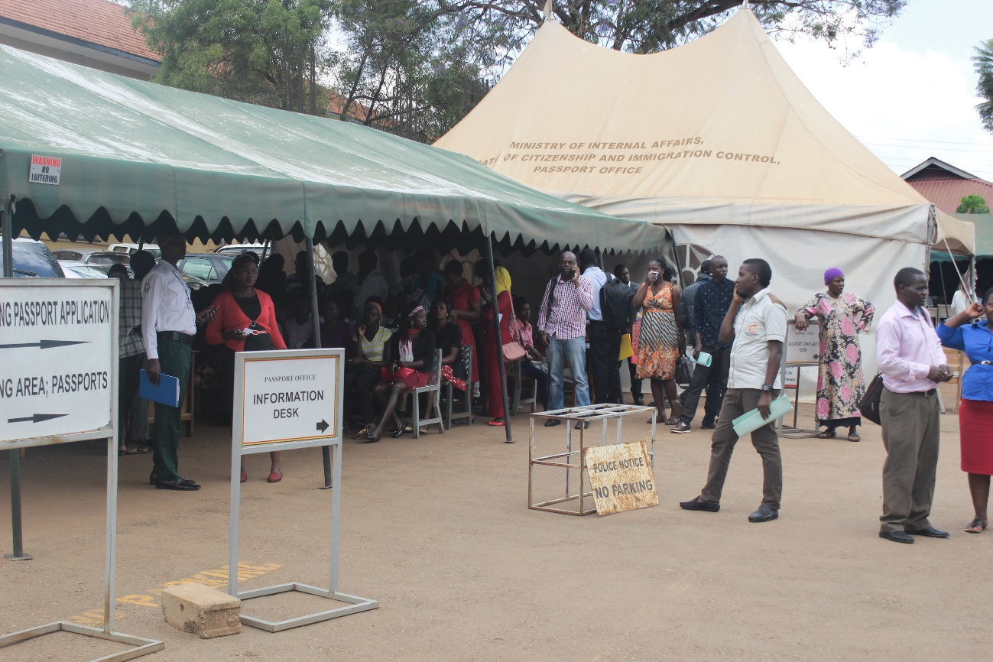
Before
All processes were manual from passport applications to traveller processing at boarders and the airport to facilities offered and deportations
The turn around time for passport processing was two weeks to 3 months to never. Loss of submitted applications was normal
There were leakages in Non tax revenue, corruption was at unprecedented levels acquisition of services was a nightmare
The procedures for any service was unclear there was need for change from the staff, the process and the entire management

Slide 5
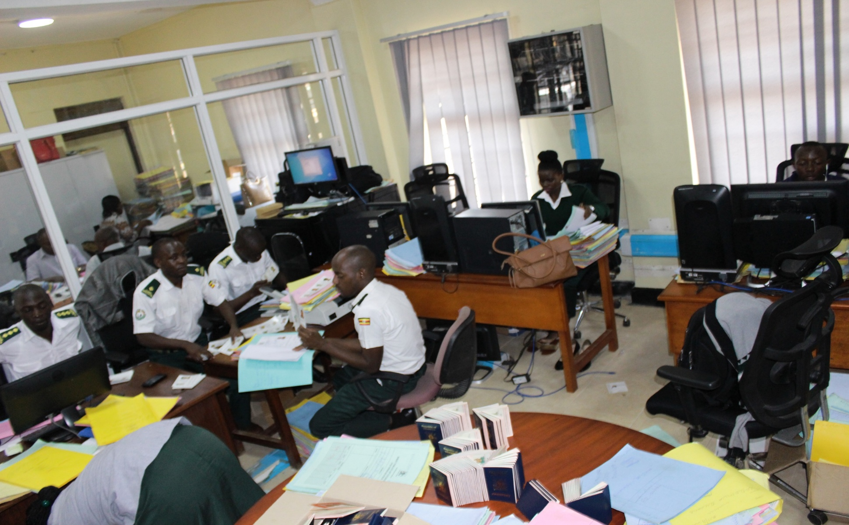
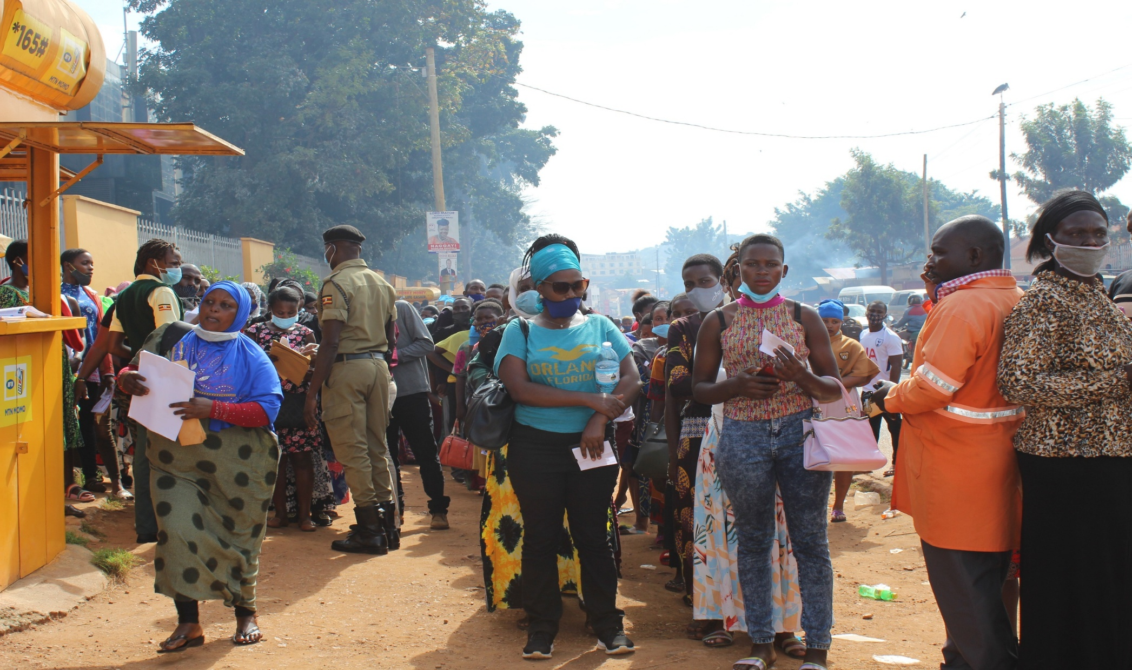


Slide 6
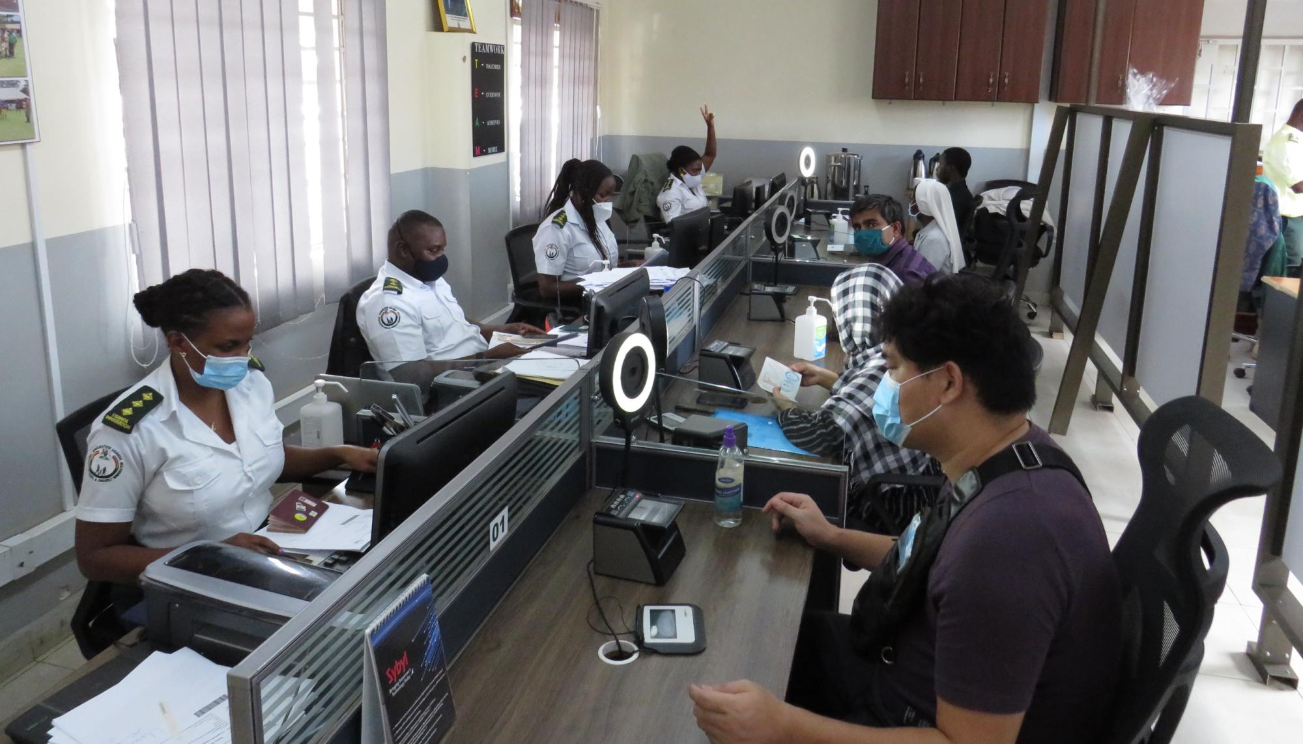
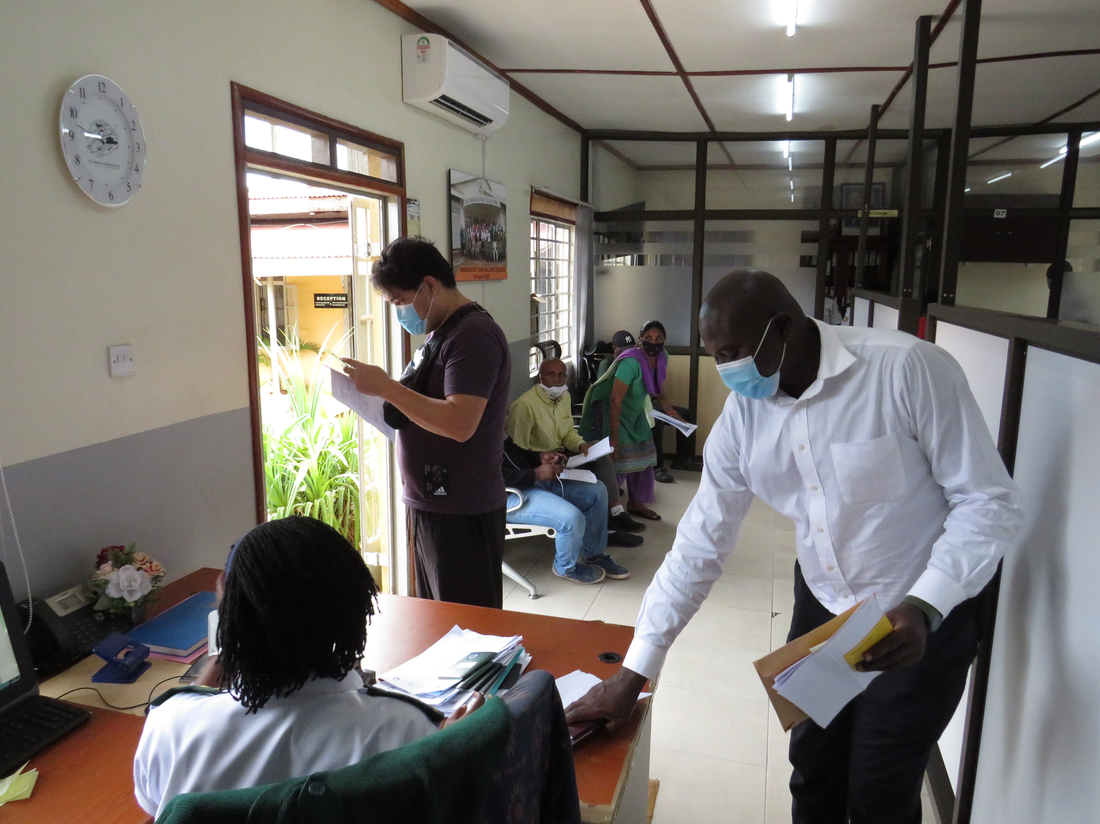
Where we are now….
Automation of all our processes passports on www.passports.go.ug other services on www.visas.immigration.go.ug
Clients can schedule appointments and track applications on set application portals
Turn around time has reduced to 7days for passport applications and 4days for visa processing
Increased revenue collections
Improved service delivery

Slide 7
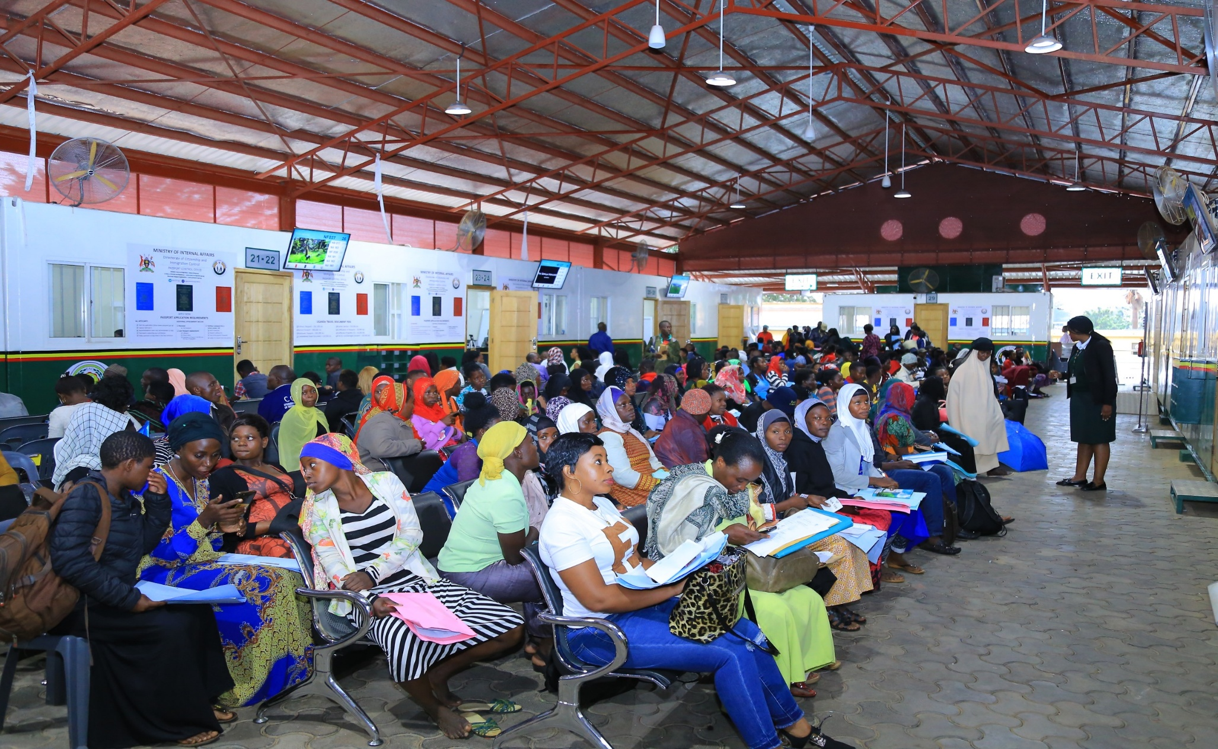
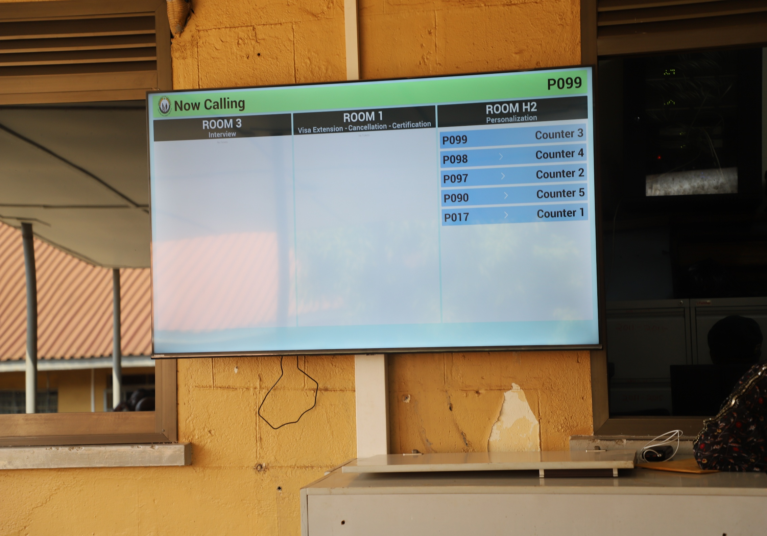
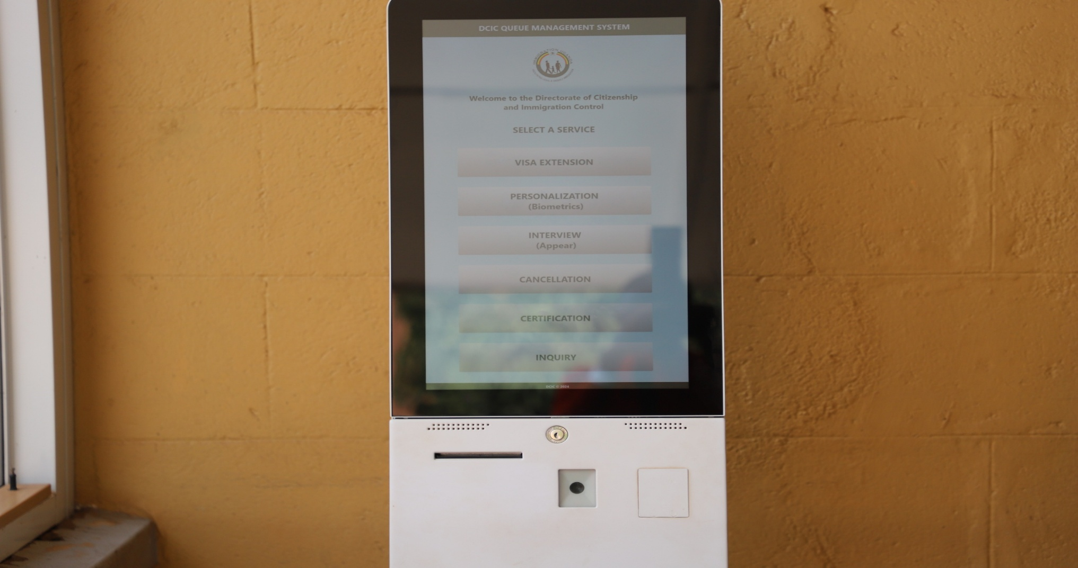
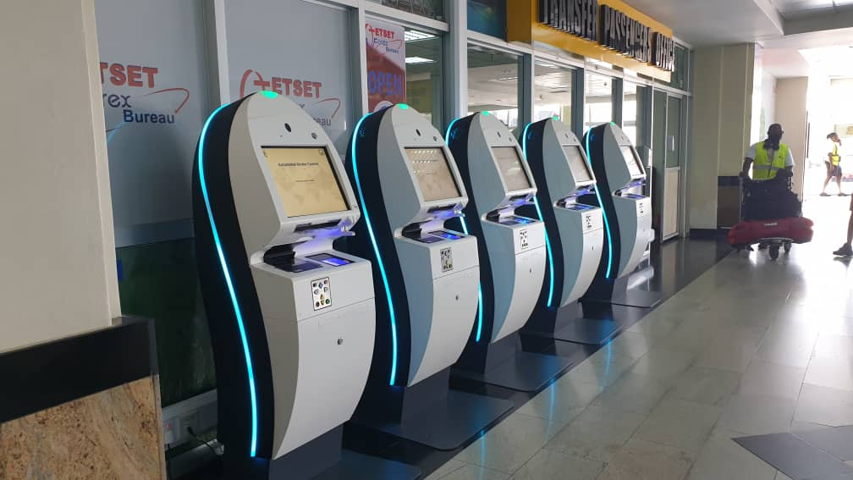

Slide 8
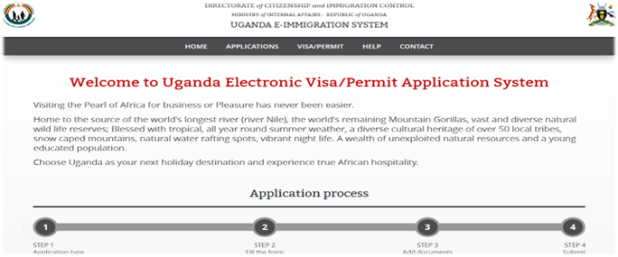
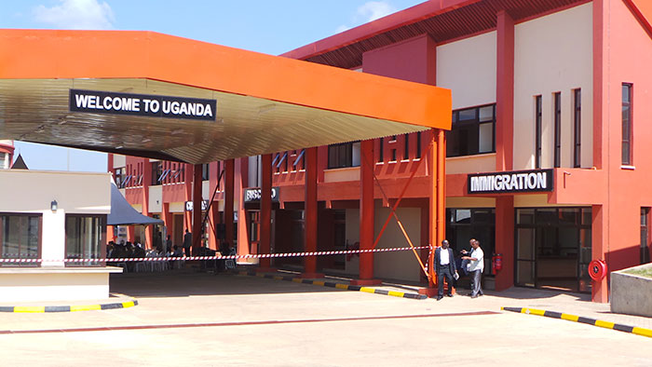

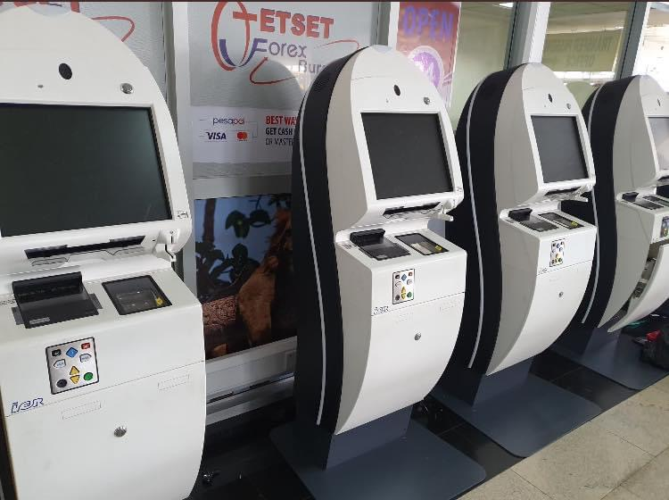
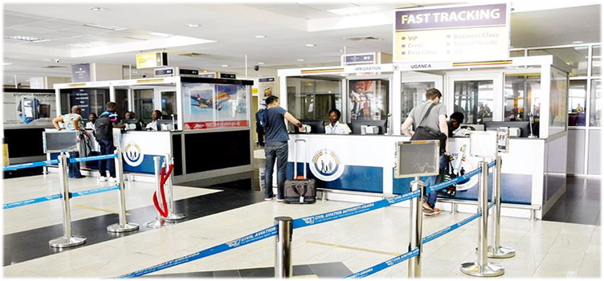
BORDER MANAGEMENT
Leveraging Technology: E-Visa system, biometric identification, eGates and data integration.
Integrated Border Management (IBM): Collaboration among agencies and One-Stop Border Posts (OSBPs).
Facilitation Schemes: Visa waivers, East African Tourist Visa, priority lanes, and public-private partnerships.

Slide 9
Contribution to NDP IV Goals
NDP IV Priority Area | NCIC Contribution
Industrialization and Private Sector Growth | Simplified work permit to attract skilled expatriates and investors i.e Class E for investors at USD 400, Class C2 for mining, Class G3 for expatriates with rare skills, Class B2 for investment in agriculture etc.
Digital Transformation | E-Immigration and e-Passports(Online application and Online payment); automated systems enhancing efficiency and improved turn around time.
Governance and Service Delivery | Reduced corruption, improved transparency, and citizen trust. Decentralization of NCIC services to regional offices
Regional Integration | OSBPs facilitating trade and cross-border business and reducing clearance time.
Security and Stability | Enhanced identity management and border surveillance.

Slide 10




FUTURE INITIATIVES
Expand Digital systems
Strengthen Partnerships
Increase Awareness
Continuous Improvement
Implement biometric systems at major entry points to enhance security and streamline processing with advanced facial and fingerprint recognition.
Enhance collaboration with neighboring countries to share best practices, data, and resources for effective border management.
Launch campaigns to inform travelers about new technologies and schemes, improving compliance and satisfaction.
Establish a framework for regular assessment of practices and experiences to adapt to changes and ensure effectiveness.

Slide 11
CHALLENGES
Limited resources hinder the ability to upgrade technology
Infrastructure gaps at remote borders.
Managing irregular migration flows.

Slide 12
Conclusion
“Efficient public institutions are the backbone of a competitive private sector and the engine of sustainable national development.”
“A strong private sector starts with an effective public sector.”
As NCIC we aim to be a model of excellence in provision of immigration services to Uganda and Migrants.

Slide 13

Thank you

