Slide 1

Driving Logistics Excellence, Policy Reform, and Digital Transformation for Uganda’s Export Competitiveness
By:
Charles MWEBEMBEZI
Chairman - UFFA
Date: 06th November 2025
Email: uffainfo@gmail.com

Slide 2
Vision:
To be an association of excellence in logistics and supply chain.
Mission:
To promote a strong ethical and professional freight logistics industry that supports trade facilitation and economic growth through capacity building and advocacy.
Core Values
Professionalism
Integrity
Transparency
ABOUT UFFA
UFFA is an umbrella association of transport and logistics companies in Uganda whose membership includes foreign, multinationals and local companies involved with freight logistics, including but not limited to: customs clearance, transport, shipping, ICD/freight terminals and warehouses/storage operations.
The Association has a membership of 185 companies that handle over 90% of Uganda's import and export cargo.

Slide 3
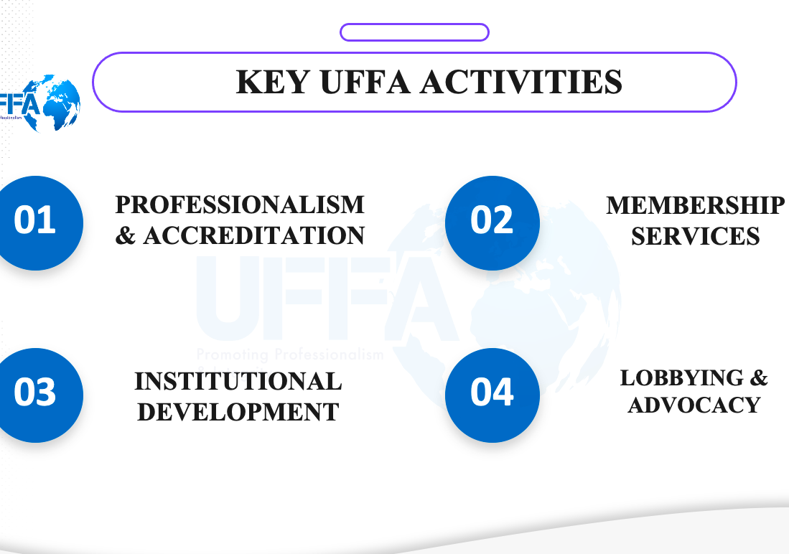

Slide 4
PROFESSIONALISM & ACCREDITATION | MEMBERSHIP SERVICES | INSTITUTIONAL DEVELOPMENT | LOBBYING & ADVOCACY
The Self-Regulation Bill – has been domesticated. A Regulatory Impact Assessment for a Legal Regulatory Framework of the Logistics Industry is partially done. MoWT is the lead agency on this project | Capacity building | We are a well structured Associations. (Executive Committee, Advisory Board, Ad hoc subcommittees and an independent Secretariat | UFFA was a key stakeholder during the drafting of the Transport & Logistics Policy.
Training & Capacity building - FIATA Diploma in International Freight Forwarding. UFFA has been accredited to administer this Program in Uganda and the Region. Uganda is only the 5th country on the continent to get this blessing. | Information dissemination | Partnerships with various stakeholders, both in the Private and Public sectors (FEAFFA, FIATA, PSFU, URA, MoWT, UIA, URC, URF…) | UFFA has representation on the technical working Group of the Presidential Investors Round Table Initiative for Transport & Haulage Sector.
- East African Customs & Freight Forwarding Practicing Certificate. 1950 graduates so far in 16 intakes. Program has played a key role in Agency licensing and enhancing professionalism in the industry | Agency Licensing |  | We have a proactive Customs & Technical Affairs subcommittee

Slide 5
Introduction: Role of Freight Forwarders
Freight forwarders are the strategic integrators of global supply chains, linking exporters, importers, customs, and transport systems for seamless cargo movement.
The Uganda Freight Forwarders Association (UFFA) represents 200+ licensed logistics and customs brokerage firms operating across Uganda and the wider East African region.
UFFA members form the bridge between private-sector traders and public-sector regulators, ensuring compliance, efficiency, and transparency along regional trade corridors.
Our mission is to drive logistics excellence through:
Trade facilitation reforms aligned with WTO-TFA & AfCFTA;
Digital transformation via EDI, FMIS, and the UeSW;
Professional capacity-building through globally accredited FIATA training.
UFFA is a catalyst for Uganda’s export competitiveness and regional trade integration.

Slide 6

Uganda’s Export Competitiveness Context
Export-to-GDP ratio <15% – strong untapped trade potential.
High logistics costs (35–40%) – among the highest in Sub-Saharan Africa.
Corridor inefficiencies, NTBs, and last-mile gaps drive cost and delay.
Efficient border management & trade facilitation are game changers for export growth.
Tenfold Growth Strategy prioritizes logistics and infrastructure for export-led industrialization.
Goal: Position Uganda as a competitive regional trade hub within EAC & AfCFTA by strengthening multimodal connectivity and digital border systems

Slide 7
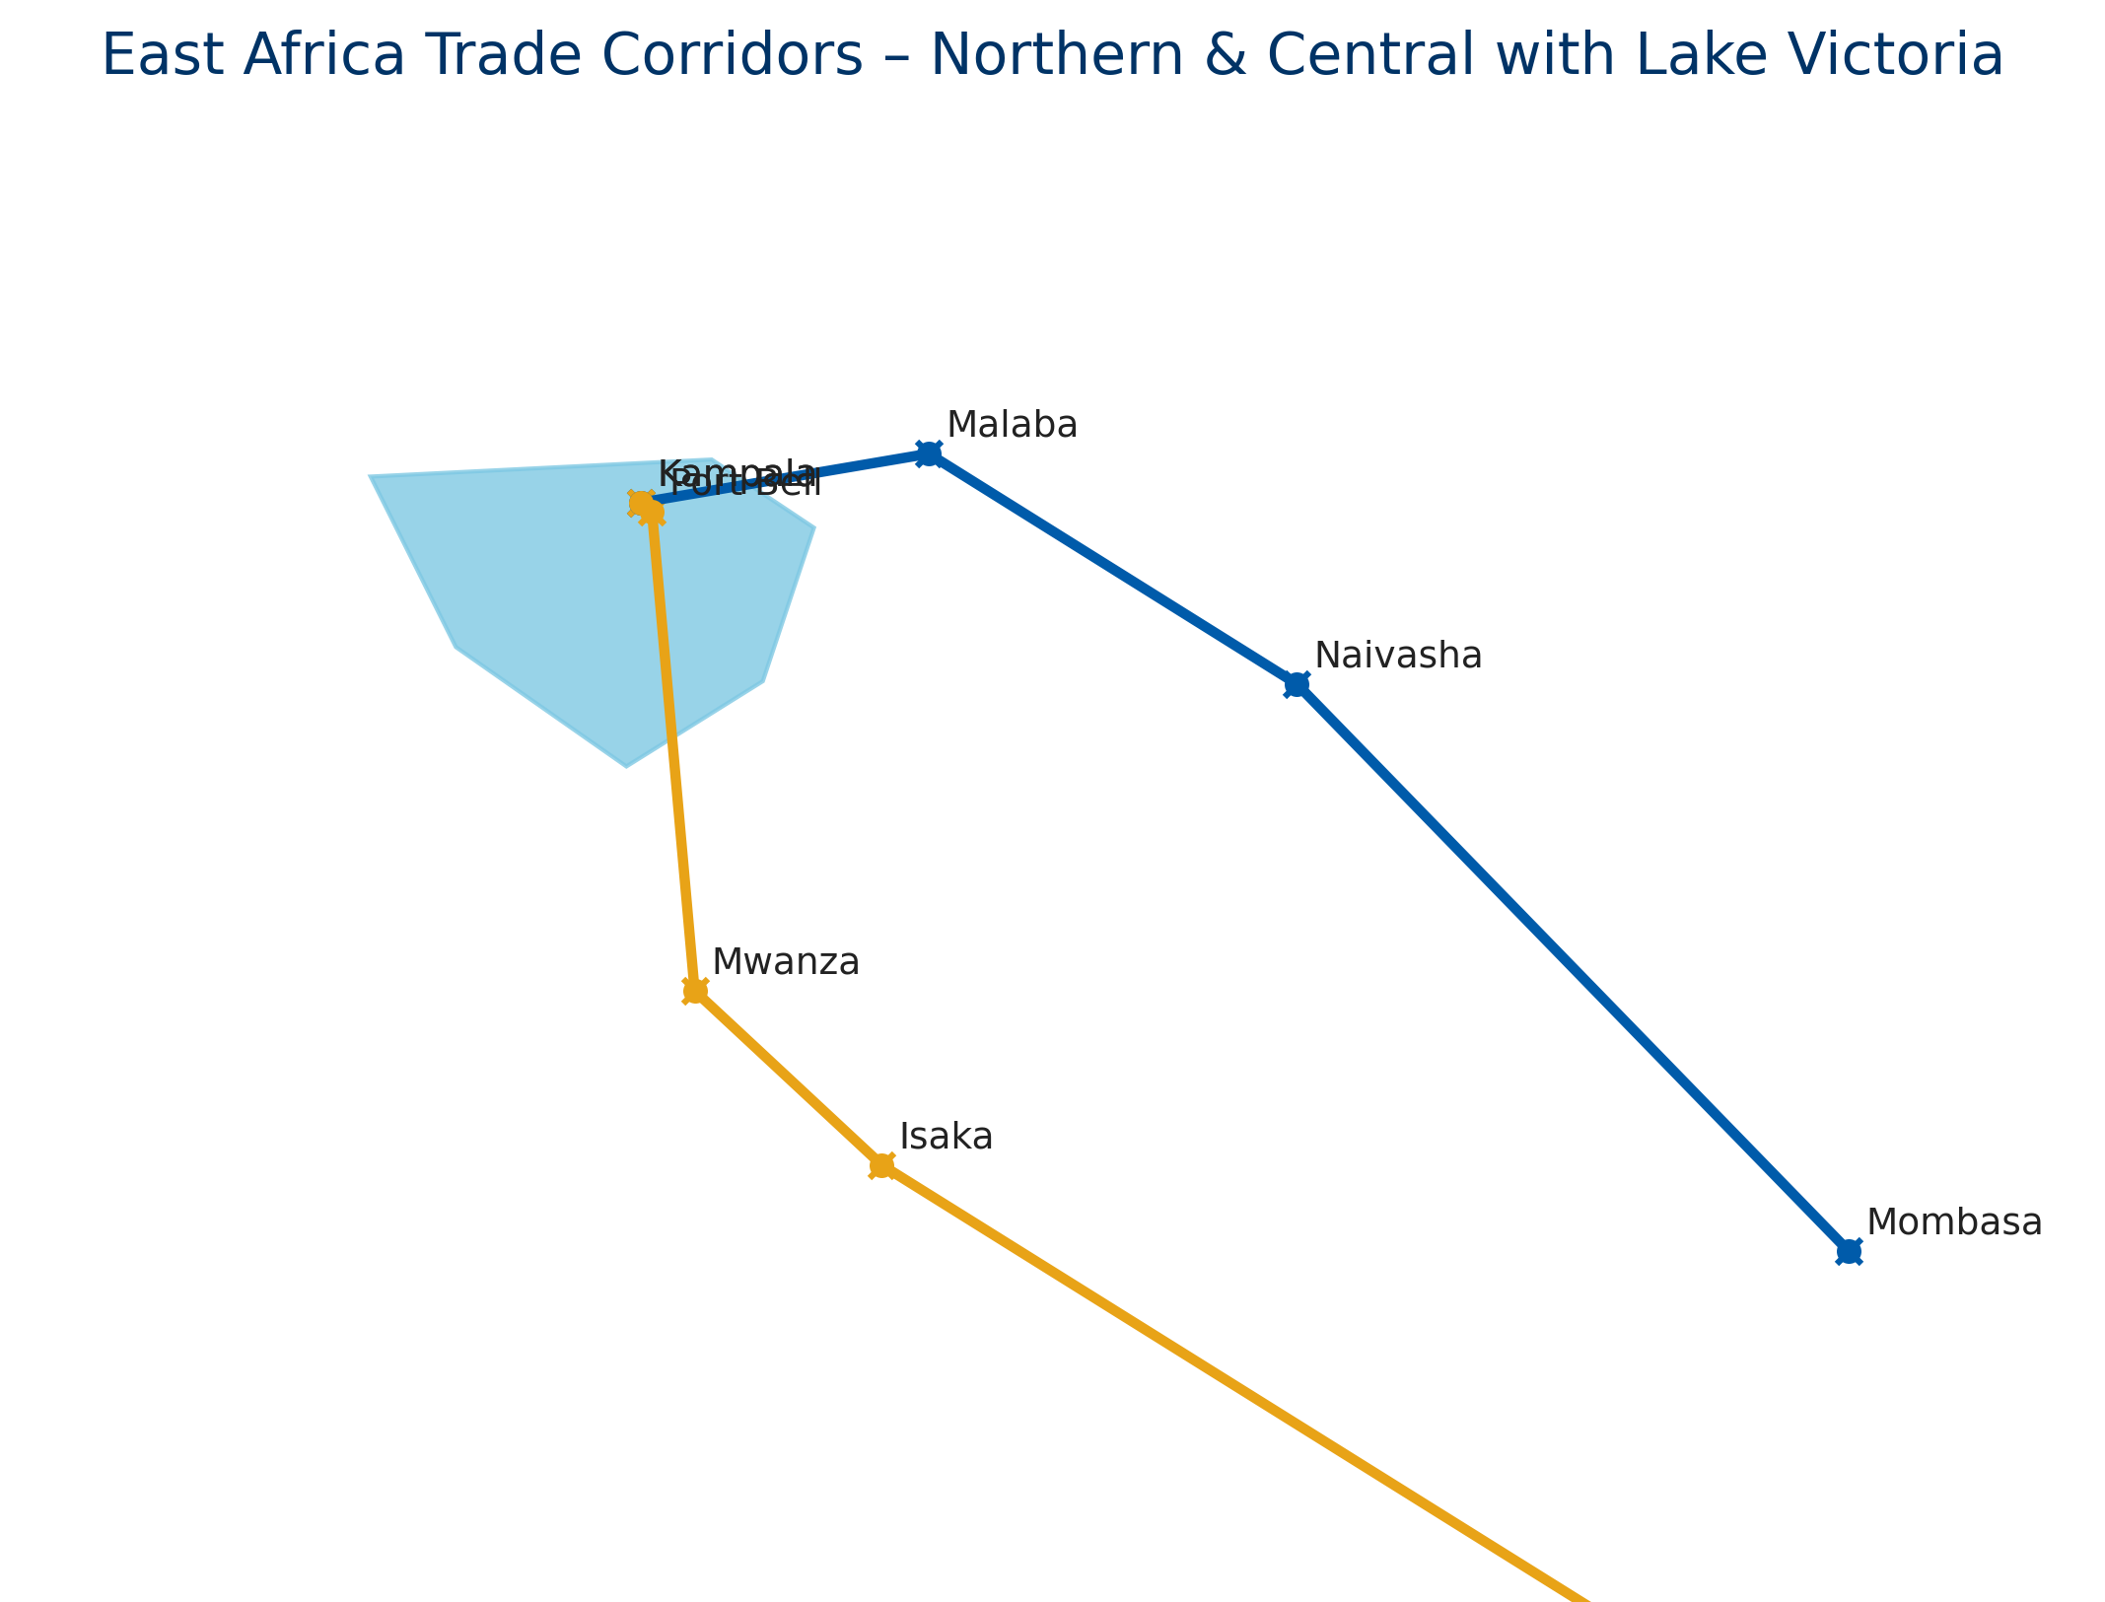
Current Logistics Realities
Land-linked economy reliant on two key regional corridors:
Northern Corridor: Mombasa – Naivasha – Malaba – Kampala
Central Corridor: Dar es Salaam – Isaka – Mwanza – Port Bell – Kampala
Each handles 8+ million tonnes annually but faces:
Multiple regulatory checkpoints
Manual, paper-based documentation
Limited multimodal connectivity
High last-mile transport costs

Slide 8
Trade Facilitation & Border Efficiency
• Single Window (UeSW): Integrates customs, inspection & licensing agencies.
• Advance Rulings (AR): Provides predictable customs decisions.
• AEO Programme: Rewards compliant traders with priority clearance.
• NTB Elimination: Harmonises standards & border procedures.
• Digital Transit Monitoring (ECTS): Cuts transit time & reduces cargo risk.
Together, these tools cut delays, lower costs, and boost trust in trade systems.

Slide 9
UFFA’s Role in Driving Efficiency & Competitiveness
Advocacy & Reform: Shapes trade-facilitation policy through NTFC, EAC & AfCFTA platforms.
Coordination: Bridges regulators & industry to streamline border and corridor operations.
Capacity Building: Delivers FIATA Diploma & CPD programs to enhance professionalism.
Digitalization: Promotes EDI, FMIS, UeSW & IoT for paperless trade.
Regional Integration: Works via FEAFFA/EFFFA to harmonize procedures and boost corridor efficiency.
Data & Insights: Provides evidence for policy and investment decisions.
Public–Private Dialogue: Builds trust and collaboration for effective trade reforms.

Slide 10
Impact of Efficient Border Management
Clearance time cut from days to hours.
Trade costs reduced by up to 25%.
Predictable delivery schedules boost export reliability.
Investor confidence rises with transparent, digital procedures.
Efficiency translates directly into competitiveness & growth.

Slide 11
Case Studies
URA AEO Programme – Clearance <24 hours for certified traders.
MV Mpungu (Lake Victoria) – 30% cost reduction on bulk cargo.
UeSW + iCMS Integration – Seamless cross-border data exchange.
These examples prove how digital integration & collaboration drive efficiency.

Slide 12

Challenges Hindering Efficiency
Fragmented institutional coordination across border agencies.
Low digital adoption by small freight operators.
Inconsistent application of EAC TFA & AfCFTA commitments.
Infrastructure gaps at ICDs and border posts.
Skills deficit in digital freight management.

Slide 13

Integrate UeSW with EAC systems.
Develop multimodal links: rail–lake–road connectivity.
Invest in digital logistics skills via UFFA–URA–MTIC partnerships.
Strengthen NTFC coordination for efficient agency alignment.
Encourage PPP investment in dry ports & logistics hubs.
Focus on integration, innovation & collaboration.

Slide 14
Alignment with Tenfold Growth Strategy
Pillar 1: Export-led Industrialization UFFA enhances export growth through efficient logistics, digital customs solutions, and reduced trade costs — making Ugandan products more competitive regionally and globally.
Pillar 3: Infrastructure for Competitiveness UFFA actively supports both hard infrastructure (rail, lake, road connectivity) and soft infrastructure — including trade policies, digital systems, and streamlined procedures — to strengthen corridor efficiency and resilience.
Pillar 4: Public Sector Efficiency Through the NTFC, UFFA promotes collaboration, harmonized documentation, and data-driven coordination among border agencies to improve service delivery.
Overall Alignment: UFFA’s interventions — corridor optimization, trade-facilitation reforms, and public–private dialogue — directly advance all three pillars, positioning logistics as a core driver of Uganda’s Tenfold Growth Strategy.

Slide 15

Call to Action
“Seamless trade is not an aspiration—it is an obligation.”
Efficient border management and trade facilitation are the engines of Uganda’s export-led future.
Let us work together—public and private sectors—to turn efficiency into competitiveness.

Slide 16
THANK YOU

Slide 17

Q&A / Discussion

